Slide 1
Lariat Rent-A-Car
Trevor Johnson

Slide 2
Context
Situation
Lariat currently operates a fleet of 4,000 vehicles across 50 branch locations, resulting in ~$53M in yearly revenue at a 37% profit margin
Complication
Lariat would like to make smarter business decisions based on the revenue and costs associated with their vehicle fleet
How can we maximize revenue while minimizing costs?
Question

Slide 3
Method
Using various data sets as provided by Lariat; Branch, Vehicle, Reservation, and Cost data were combined to analyze Lariat’s business in 2018
Profitability was studied by Branch and Vehicle (year, make, model)
Potential pricing and fleet strategies were modeled in order to identify how to best improve Lariat’s profit margin

Slide 4
Business Snapshot
Revenue per Branch
$1,056,604
Revenue per Vehicle
$13,207
Total Cost per Vehicle
($8,269)
Profit per Vehicle
$4,938

Slide 5
Test Strategies
Strategy 1
Raise rental price 5%, assume same demand
Strategy 2
Replace vehicles below 10% profit margin with over 50% profit margin vehicles, assume same demand
Strategy 3
Increase fleet by 10%

Slide 6
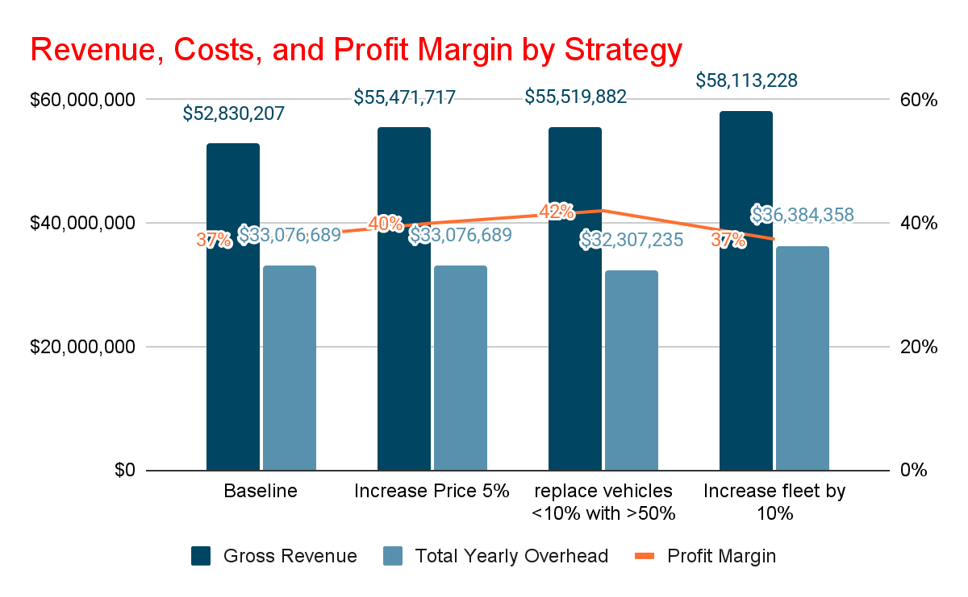

Slide 7
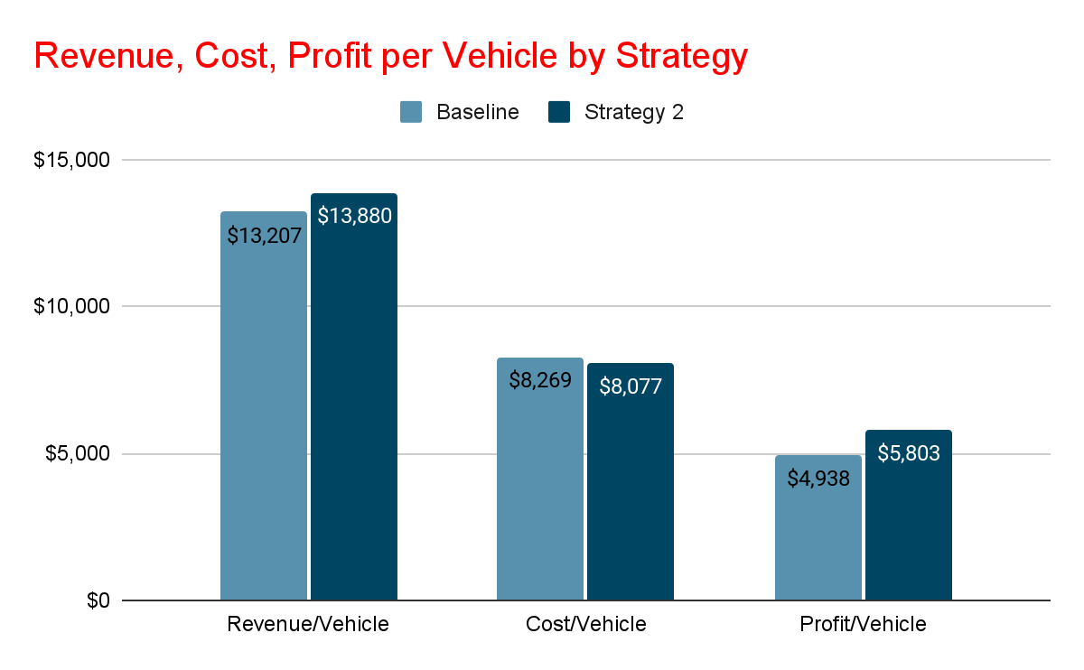

Slide 8
Suggestion
By Implementing Strategy 2 Lariat can achieve:
5% increase in Revenue
2% decrease in Car and Insurance Costs
5% increase in Profit Margin
Maintain pricing flexibility

Slide 9
Appendix
Car ID Mapping (maps a unique ID to a car year, make, and model)
Car Costs (monthly car and insurance costs per Car ID)
Car Revenue (number of rental days, Branch ID, and rental price per day per Car)
Branch Locations (Branch ID mapped to city and state
Analysis Model (Excel Workbook with Branch, Vehicle, and Strategy Dashboards)

Slide 10
THANK YOU

